Slide 1


Slide 2

The Problem Statement
“Automated mapping of adverse road conditions using various sensors and algorithms”

Slide 3

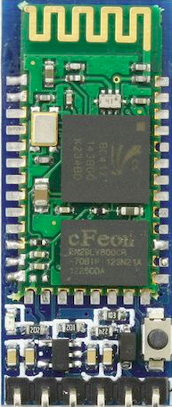

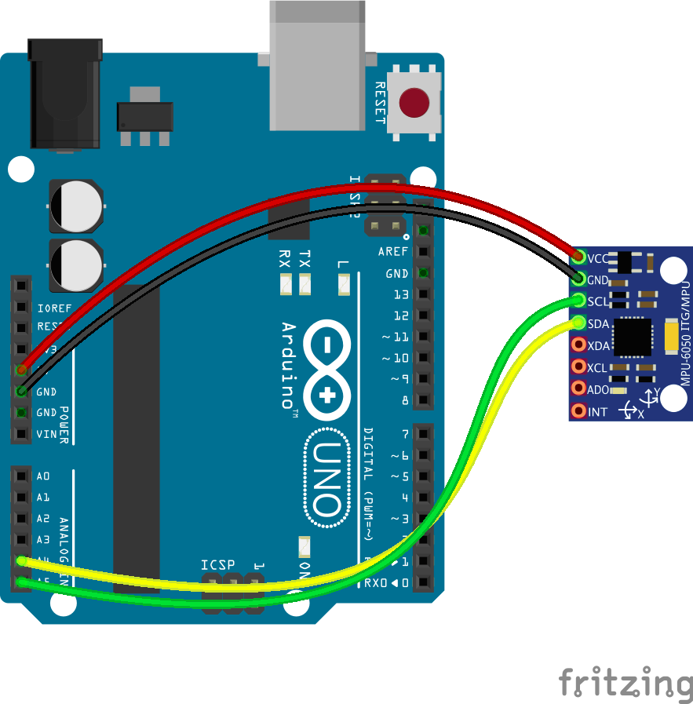

Proposed Solution

Slide 4

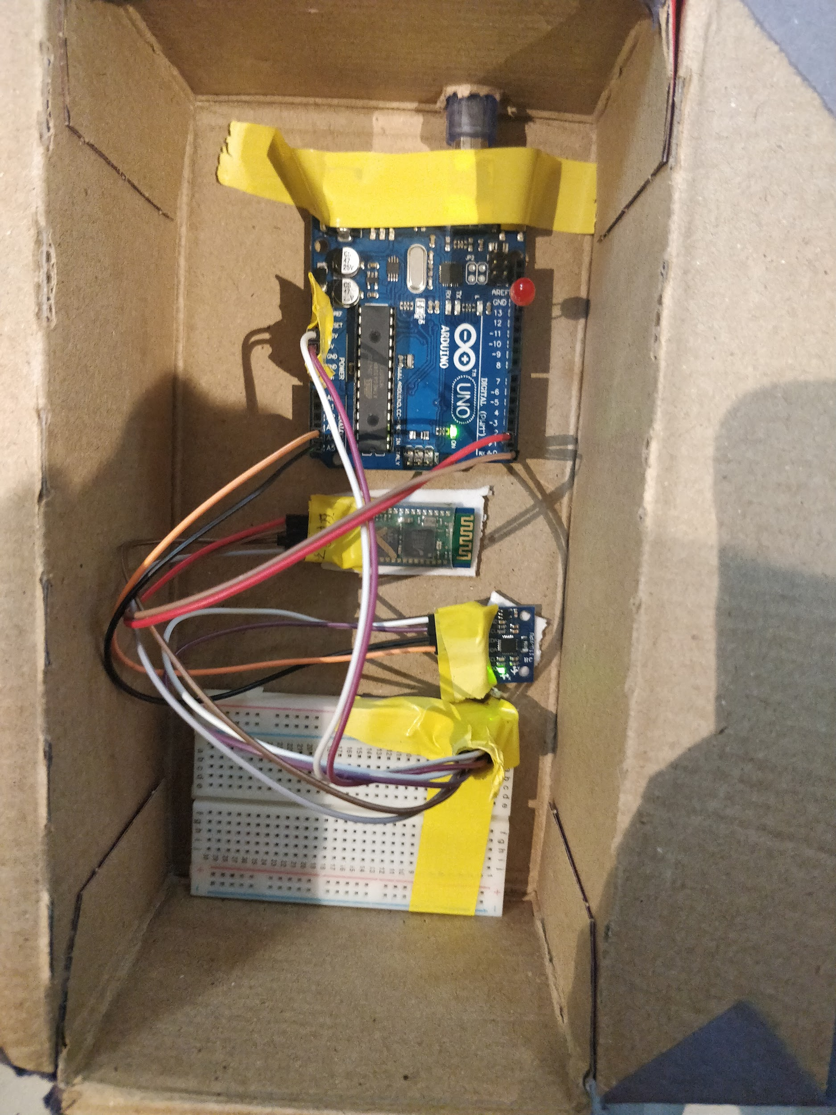
Architecture(proto)

Slide 5

Architecture
(V1)

Slide 6
Mapper Mode
Navigation Mode
Connect to the device
Enter Destination
Start mapping ARCs
Enter Destination
Start Navigation
Get ARCs on Map

Slide 7




Technology Stack

Slide 8

Voilá !

Slide 9



Slide 10

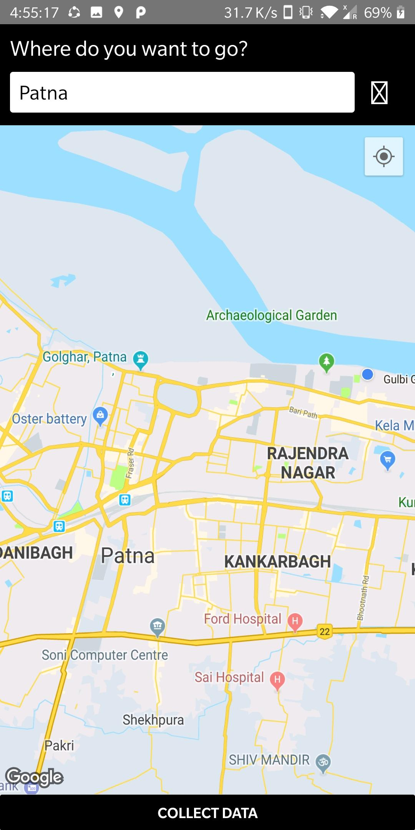

Slide 11
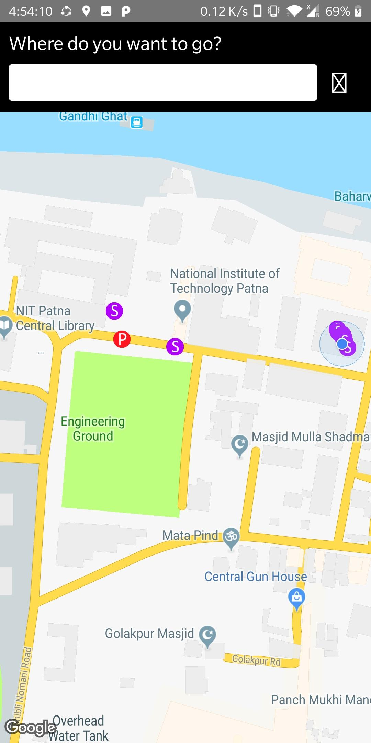
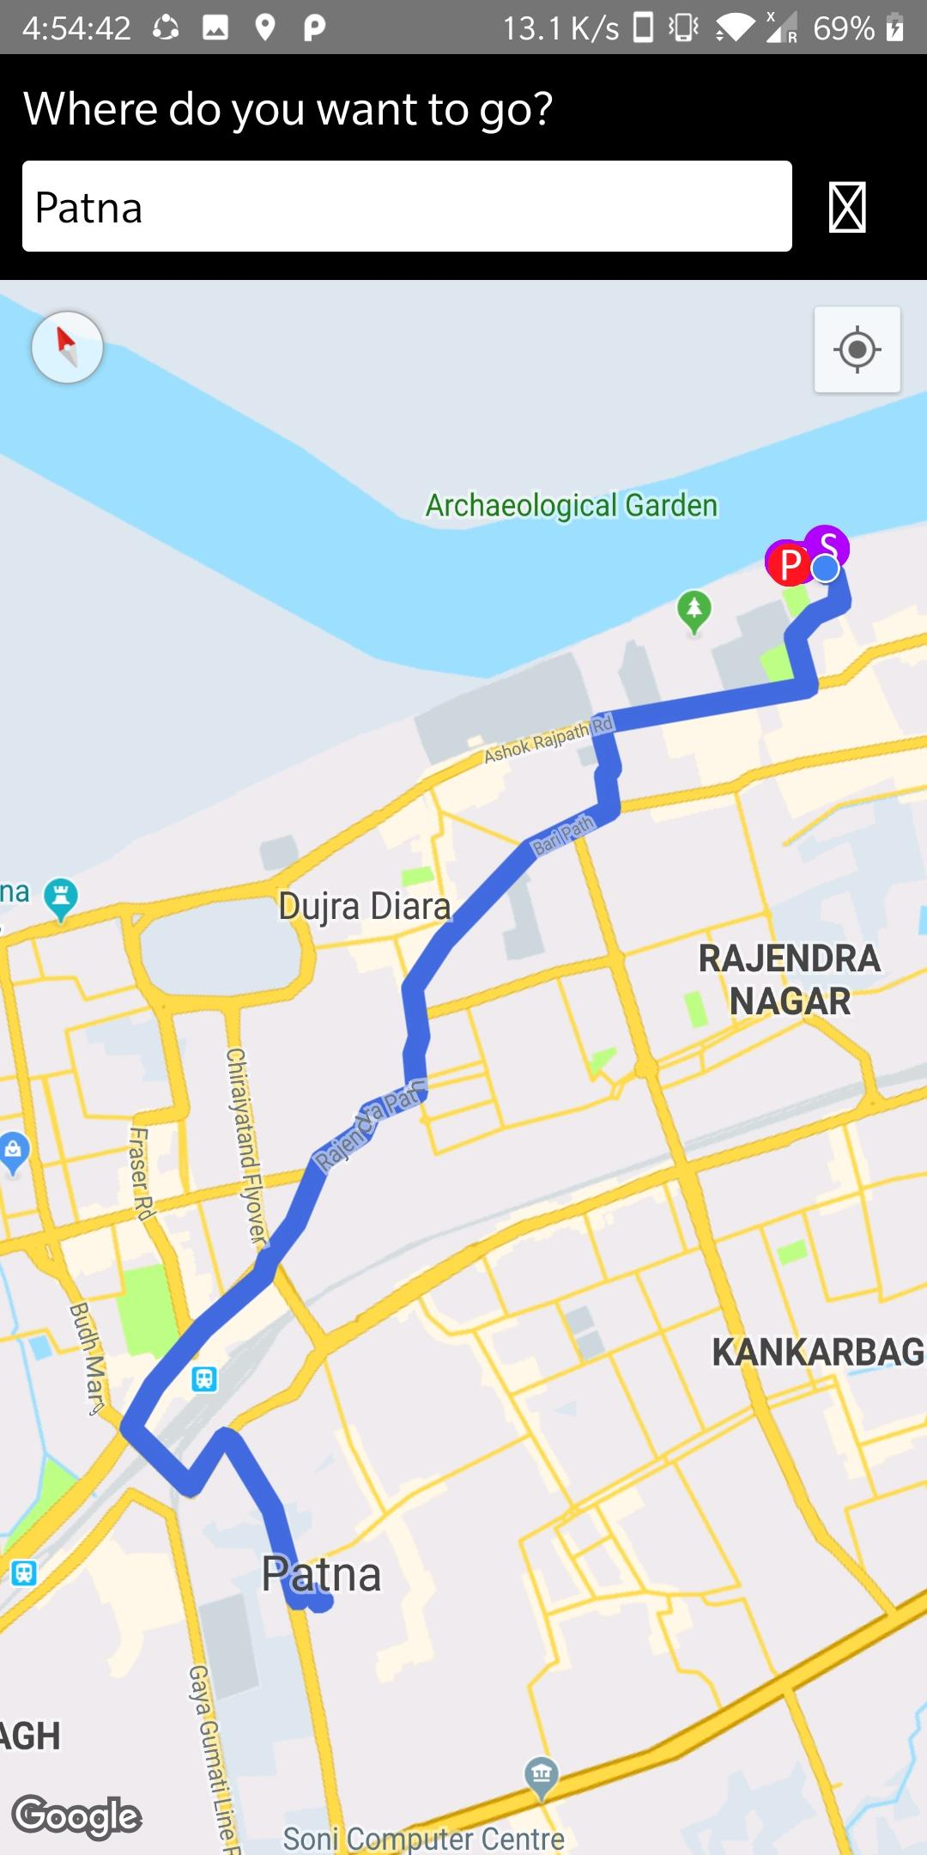

Slide 12
How are we different
Cost Effective Approach
Real Time Mapping
Ease of Use
Tested in real time environment.

